Slide 1
secure data hiding in images using setganography
CAPSTONE PROJECT
Presented By:
Student Name : SWARNIM KUMAR
College Name & Department : KALINGA INSTITUTE OF INDUSTRIAL TECHNOLOGY
SCHOOL OF COMPUTER ENGINEERING

Slide 2
OUTLINE
Problem Statement
Technology used
Wow factor
End users
Result
Conclusion
Git-hub Link
Future scope

Slide 3
Problem Statement
With rising cybersecurity threats, traditional encryption makes sensitive data transmission obvious, attracting attackers. Steganography provides a discreet way to hide information within images, but existing methods face issues like low capacity, weak robustness, and vulnerability to detection.

Slide 4
Technology used
Google Colab – Cloud-based environment for execution and file handling
Python– Core language for implementation.
OpenCV– Image processing and manipulation.
OS Module – Handling file operations.
ASCII Encoding – Converting text to ASCII for embedding.
Least Significant Bit (LSB) Steganography – Hiding text data in image pixels.

Slide 5
Wow factors
Google Colab Integration – Easy access and execution without requiring a local setup.

Slide 6
End users
Journalists & Whistleblowers – Securely transmit sensitive information without detection.
Government & Intelligence Agencies – Covert communication and secure data exchange.
Cybersecurity Professionals – Protect confidential data from hackers and surveillance.
Forensic Experts – Embed hidden messages in images for tracking and investigation.
Military & Defense – Secure transmission of classified information.
Corporate Sector – Hide proprietary data within images for secure internal communication.
Individuals Concerned About Privacy – Personal data protection from cyber threats.

Slide 7
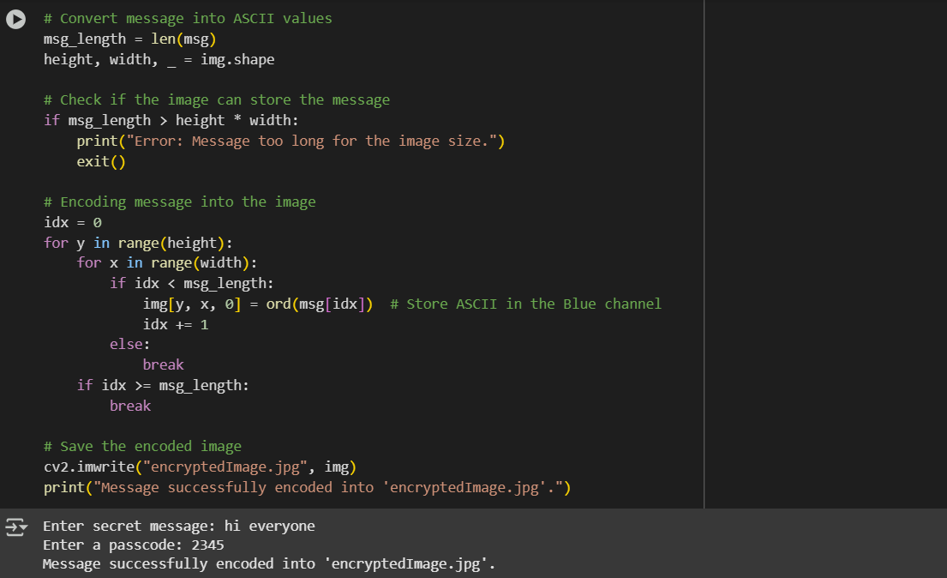
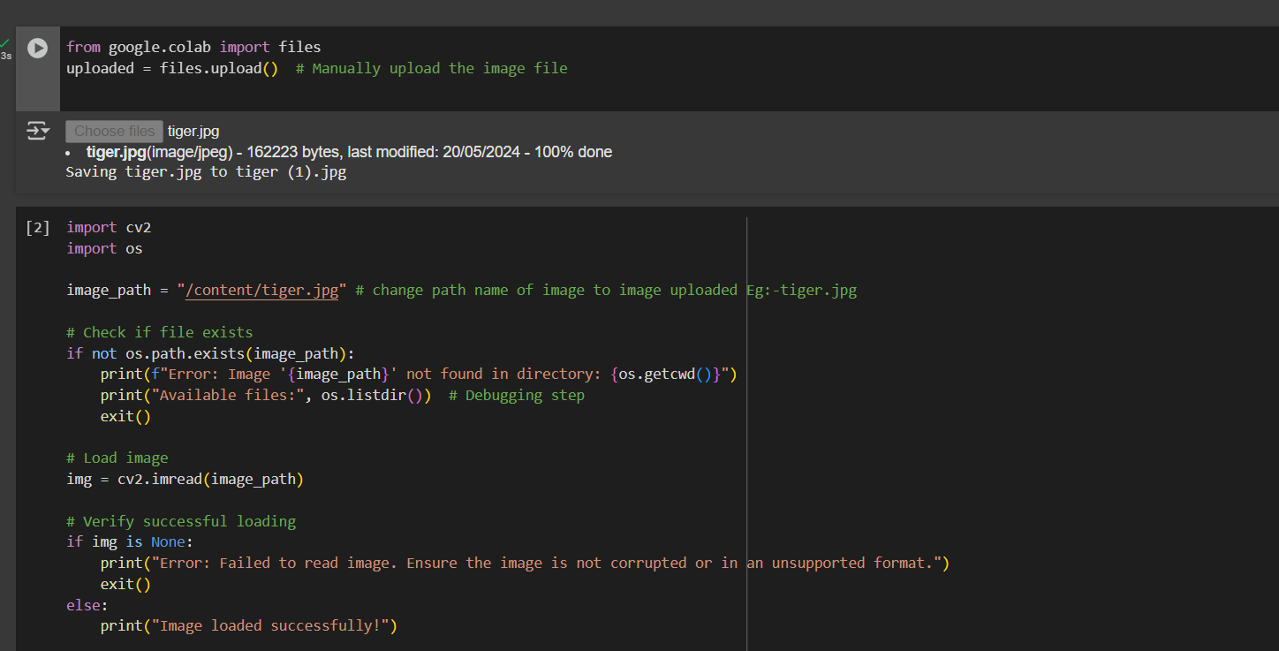
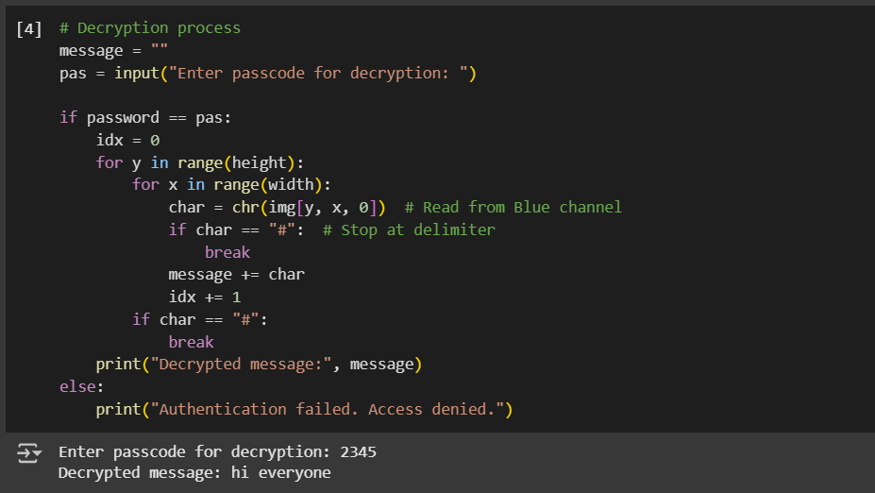
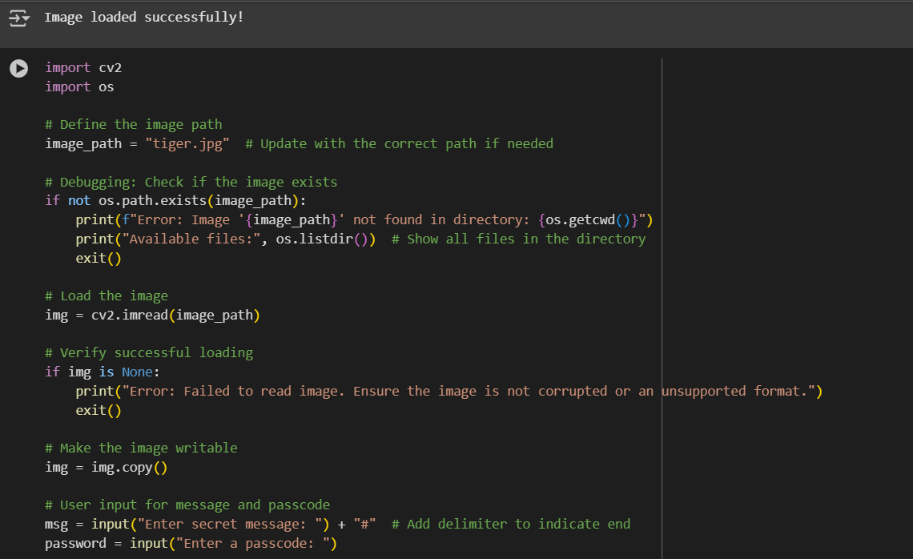
Results

Slide 8
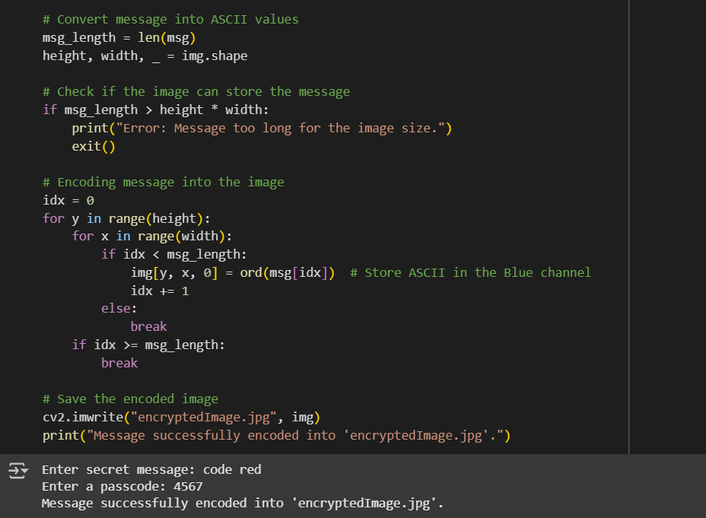
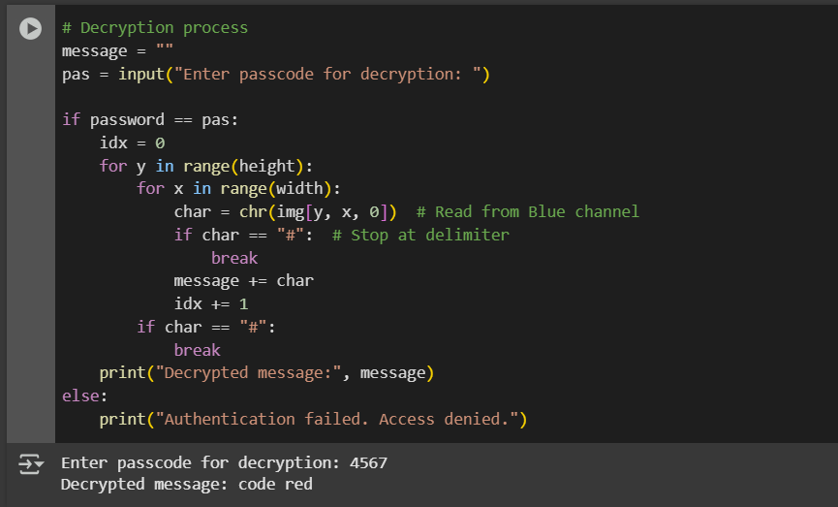
Results

Slide 9
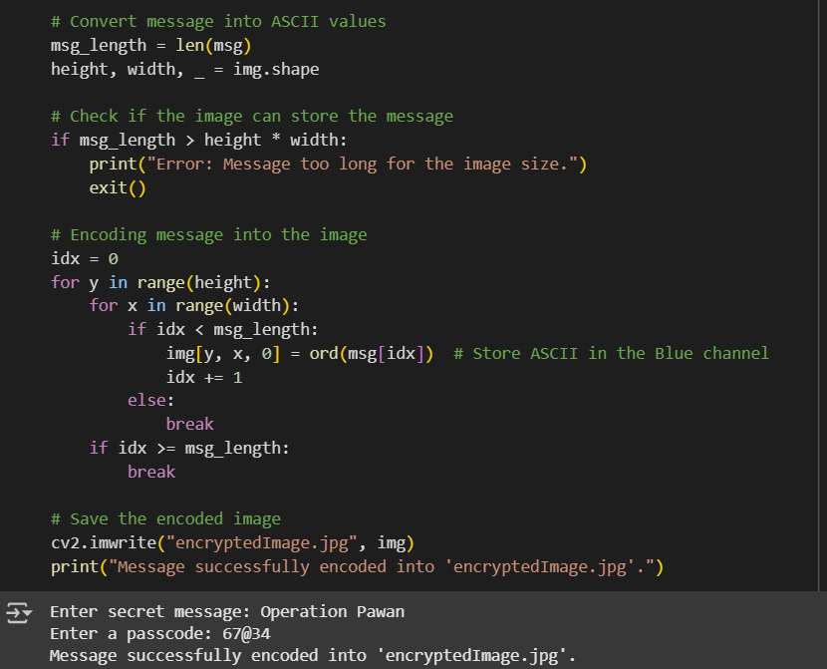
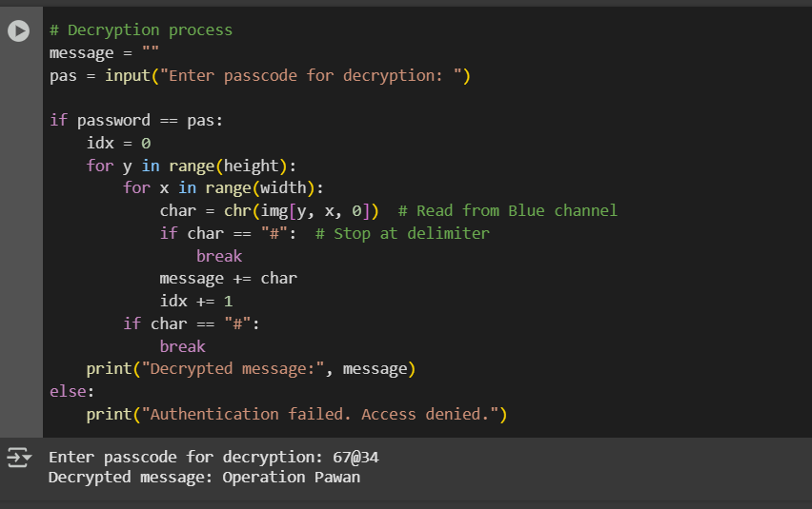
Results

Slide 10
Conclusion
Our project demonstrates a secure and efficient method of data hiding using steganography. By embedding confidential information within images, we enhance data privacy and security while ensuring undetectable communication. This technique is valuable for individuals and organizations needing covert data transmission, cybersecurity, and digital forensics. With the growing threats in data breaches and surveillance, our solution offers a practical and innovative approach to secure communication.

Slide 11
GitHub Link
https://github.com/sk2329159/Steganography.git

Slide 12
Future scope(optional)
Advanced Encryption Before Hiding Data – Encrypt the message (AES, RSA, or hashing) before embedding it in the image.
AI-Enhanced Steganography – Use AI to decide the best pixels for data hiding to avoid detection.
Multi-Layered Steganography – Hide data within multiple image layers for extra security.
Real-World Use Case Demo – Show a practical application (e.g., secure message transmission, watermarking, or forensic data hiding)

Slide 13
THANK YOU

